Slide 1
Case Study 5: Deep Q-learning for Tic-Tac-Go challenge
Reporter: Zong Fan
Email: zongfan2@illinois.edu

Slide 2
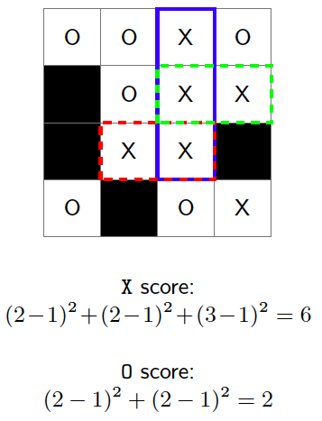
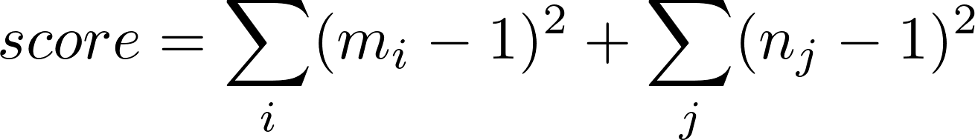
1. Objective
Train an AI agent with deep Q-learning to play Tic-Tac-Go.
What is Tic-Tac-Go?
Similar to Tic-Tac-Toe game, but is expanded 4×4 grid.
The winner is the player whose final score is higher than the other's.
The final score is computed as:
m_i, n_j is length of chain in the i th row and j th column.

Slide 3
2. Method
In this study, we employed deep Q-learning to train a deep neural network as the agent.
As the lecture said, the pipeline to train a deep Q-learning model includes:
Construct a network Q(s,a) with random weights W.
Generate a trajectory s₀, a₀, r₀, ..., s_{T},r_{T}.
Compute Q-factor target for each (s, a) pair as:
Compute loss between the network and the target using MSE loss.
Backpropagate the gradient to update network parameters W.
Go to #2 and repeat.
r: reward of the state, γ: discounting factor

Slide 4
2.1 Player 1: Deep Network
The input of the network is the borad status, including:
blocked positions S_{b}
empty positions S_{e}
palyer 1 occupied positions S_{p1}
player 2 occupire positions S_{p2}
The output of the network is the probability of action to put on each board locations.
We define the dimension of input and output as (N, 4, 4, 4) and (N, 16).
1 | 2 | 3 | 4
5 | 6 | 7 | 8
9 | 10 | 11 | 12
13 | 14 | 15 | 16
Output position code:

Slide 5
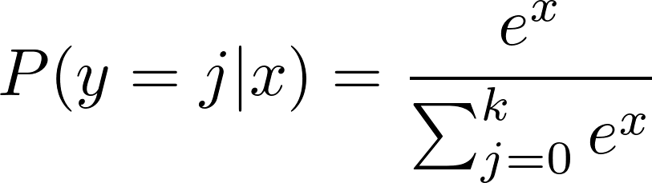
2.2 Network architecure
Input
CONV
(c=64, k-4, s=2, p=1)
We designed a convolutional neural network with 2 convolutional layers and 2 fully-connected layers.
Rectified linearUnits (ReLU) is followed after each layer as the non-linear acitvation function.
The final softmax layer transform the output values into probabilities.
BN
ReLU
CONV
(c=256, k-2, s=1)
ReLU
FC
ReLU
FC
Softmax

Slide 6
2.3 Player 2: random player
For comparison, we designed a random player who randomly choose a empty position as the action when it was his turn.
After the intial deep network player was trained, it could be used as the baseline AI agent for further optimization.

Slide 7
2.3 Training
We trained the network by setting discounting factor as 0.95.
Reward for win, lose, tie is 1, -1, 0 respectively.
Adam optimizer is employed to update model weights with initial learning rate as 0.0001.
1000,000 rounds of games are played to train the network.
To exploit game states, we play random rollout in first 1/4 iterations with proability of 0.6; it drops to 0.1 for the next 1/4 iterations; and the rest iterations uses 0.05.

Slide 8
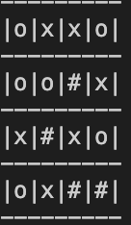
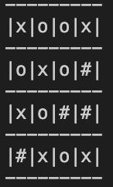
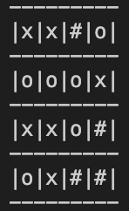
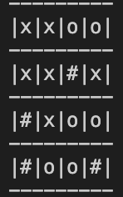
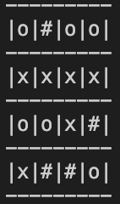
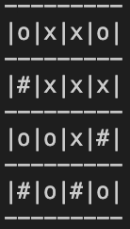
3. Results
During the training process, the maximum average reward of Q-player reaches 0.65. It indicates more training iterations should be done to achieve higher performance.
Several game sets:
Q-player: player 2 (o)
Q-player: player 1(x)
# is blocked positions

Slide 9
4. Code
Link to access the code: https://gist.github.com/CasiaFan/6a83b4a159fc5a2f3ed75e9a76f38aa8

